Slide 1


CMMI OVERVIEW
CMMI Overview Session I – 80 Mts
Summary (Q & A) 10 Mts
Total 90 Mts
Notes:
Welcome participants to the session, if this is the first session of training program proceed with introductions after a brief (2-3minutes) welcome speech.
It is always a good idea for faculty to first introduce him/herself before moving on to participants.
Ask participants to introduce on the following parameters :-
Name
Total experience
Experience at
Group and Project name
Any familiarity with QMS

Slide 2
OBJECTIVES
  Brief About Quality
  CMMI Overview
  CMMI VS ISO
  CMMI Assessment
  Brief About QMS
  Proposed Quality Framework
Notes:
At the end of introductions, bring participants back to the class by stating objectives of the current module - INTRODUCTION TO QMS.

Slide 3


WHAT IS QUALITY ?
……………………………………………………………
………………………………………………………………
………………………………………………………………
………………………………………………………………
………………………………………………………………
………………………………………………………………
………………………………………………………………
………………………………………………………………
Notes:
Juran's view is that, "Quality does not happen by accident it must be planned".

Slide 4

WHAT IS QUALITY ?
“The totality of features and characteristics of a product or service that bear on its ability to satisfy stated or implied needs.”
- ISO 8402

Slide 5

WHY QUALITY ?
  Ensure consistency in meeting customer requirements
    By producing the output that satisfies customer requirement the very first time
  Eliminate variations by ensuring that
    Every process is performed in a standardized manner
    Every process gives the desired output consistently
    Assignable causes of variations and loopholes in the system are removed by doing root cause analysis
Notes:
Besides, points mentioned in the slide, some by-products of following QMS are :-
uniform terminology
increased marketability (everyone looks for third party certification)
increase in reusability
increased quality focus

Slide 6
BENEFITS OF QUALITY PROCESSES
  Consistency of Process
  Process monitoring method
  Quick identification of cause of quality fluctuation
  Enhances market image & customer satisfaction
  Enables monitoring of process improvement
  Person independence
  Achieve organizational goals
  Highlights variations at the early stage, which can be analyzed
  Better control over the project
Notes:
Based on the earlier discussion, let us now take a look at some of the benefits provided by QMS. It is important to mention here that merely following QMS in letter does not provide some or all of these benefits, it needs to be followed in spirit to derive maximum mileage out of QMS.
It is worthwhile mentioning here that the experience shows that retrofitting does not help for the sake of documenting what has happened. Instead what is required is “Follow QMS while performing tasks”. e.g. there is no point in filling review report one week after the review, fill review report during the review itself.
Bottom-line to understand is that “We are not following QMS for auditor, we are following QMS for our own benefit”.

Slide 7
MYTHS & TRUTHS ABOUT QUALITY
  Myths:
    Quality Control or inspection
    A super checking activity
    A massive paper generator
    A major cost area
    A panacea for all ills
    Additional activity to be performed
  Truths:
    Cost effective
    Aid to productivity
    Good Management
    Everyone's Responsibility
    Continuous improvement
    Organizational improvement
Notes:
Share with participants that there are many wrong notions about QMS, some of these are listed as myths, on the contrary what QMS is, is listed as truths.
State the fact that adherence to QMS alone does not lead to successful projects, it however increases the probability of a successful projects. There are examples in Pyramid for both kind of projects - successful without QMS and unsuccessful with QMS. So QMS does not guarantee success.
It only lists down the basic practices and the organizational way of doing activities.

Slide 8


WHAT IS COST OF QUALITY ?
The cost of quality, or not getting it right the first time
Failure costs
Scrap, rework, corrective actions, warranty claims, customer complaints and loss of customer
Appraisal costs
Inspection, compliance auditing and investigations
Prevention costs
Training, preventive auditing and process improvement implementation

Slide 9
CMMI
Overview

Slide 10
Why do Software Projects slip?
Poor estimating techniques; no historical data
Requirements not properly managed
Poor project management
Resource attrition
New/risky technology

Slide 11
An Immature Process
Ad hoc; no fixed process followed
Highly dependent on individual “heroes”
Low visibility into progress and quality
Meeting schedules is the only goal even at
the cost of quality
Excessive maintenance cost
Longer learning curves for new employees

Slide 12
A Mature Process
Defined, documented, and continuously improving
Consistent with the way the work is actually done
Better management visibility and control
Verifiable processes
Constructive use of product and process metrics
Disciplined use of technology

Slide 13





What do we mean by “Software Process”
Software process - a set of activities, methods, practices and transformations that people use to develop and maintain software and the associated products(IEEE)
Procedures and methods defining
the relationship of tasks
Process
People with skills,training
and motivation
Tools to execute

Slide 14


What is Capability Maturity Model for Software?
The application of process management and quality improvement concepts to software development and maintenance.
A guide for evolving toward a culture of engineering excellence.
A model for organizational improvement.
CMM does not address :
  specific tools, methods, and technologies
  system engineering, marketing and other business functions
  human resources

Slide 15
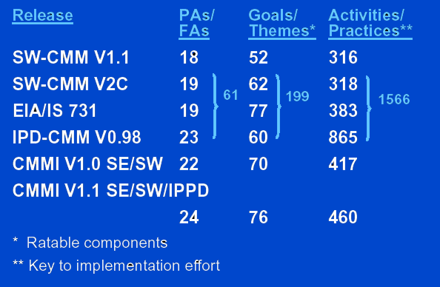


Integration of
Integrate Source Models
  SW CMMM v2.0c
  EIA/IS 731 SECM
  IPPD CMM draft v0.98
Consistent with ISO 15504

Slide 16
Different Standards under CMMI
Different body of Knowledge
  Software (SW)
  System Engineering (SE)
  Integrated Product and Process Development (IPPD)
  Supplier Sourcing (SS)
Standards are combinations of different body of knowledge

Slide 17

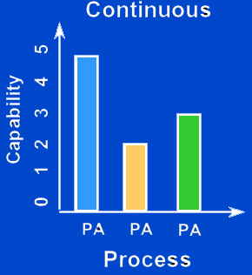
Representation
Staged
  5 Maturity Levels
  From SW CMMI
Continuous
  6 Capability Levels
  From EIA/IS 731 ISO 15504

Slide 18
CMMI - Representation
Process Area – A process area is a cluster of related practices in an area that, when performed collectively, satisfy a set of goals considered important for making significant improvement in that area.
Generic Goals - Generic goals are called “generic” because the same goal statement appears in multiple process areas. Achievement of a generic goal in a process area signifies improved control in planning and implementing the processes associated with that process area
Generic Practices - Generic practices provide institutionalization to ensure that the processes associated with the process area will be effective, repeatable, and lasting. Generic practices are categorized by generic goals and common features and are expected components in CMMI models.

Slide 19
CMMI - Representation
Specific Goals – Specific goals apply to a process area and address the unique characteristics that describe what must be implemented to satisfy the process area.
Specific Practices - A specific practice is an activity that is considered important in achieving the associated specific goal. The specific practices describe the activities expected to result in achievement of the specific goals of a process area.

Slide 20
CMMI - Representation
Common Features
Common features are predefined attributes that group generic practices into categories.
  Commitment to Perform (CO)
  Ensures that the organization is committed to perform the activities required by the PA
  Ability to Perform (AB)
  Ensures that the organization is capable of performing the activities required by the PA
  Directing Implementation (DI)
  Ensures that the organization knows the status and affectivity of the activities performed to satisfy the PA
  Verifying Implementation (VE)
  Ensures that the organization verifies that the activities are performed regularly and conform to requirements, processes and procedures

Slide 21
General Goals and Practices
Common for All process Areas
GG 2 Institutionalize a Managed Process
  GP 2.1 (CO) Establish an Organizational Policy
  GP 2.2 (AB1) Plan the Process
  GP 2.3 (AB2) Provide Resources
  GP 2.4 (AB3) Assign Responsibility
  GP 2.5 (AB4) Train People
  GP 2.6 (DI1) Manage Configurations
  GP 2.7 (DI2) Identify and Involve Relevant Stakeholders
  GP 2.8 (DI3) Monitor and Control the Process
  GP 2.9 (VE1) Objectively Evaluate Adherence
  GP 2.10 (VE2) Review Status with Higher Level Management
GG 3 Institutionalize a Defined Process
  GP 3.1 (AB5) Establish a Defined Process
  GP 3.2 (DI4) Collect Improvement Information

Slide 22
Specific Goals and Specific Practices – Example
CMMi Level – Level 2
Process Area – Project Planning
SG 1 Establish Estimates
  SP 1.1 Estimate the Scope of the Project
  SP 1.2 Establish Estimates of Work Product and Task Attributes
  SP 1.3 Define Project Life Cycle
  SP 1.4 Determine Estimates of Effort and Cost
SG 2 Develop a Project Plan
  SP 2.1 Establish the Budget and Schedule
  SP 2.2 Identify Project Risks
  SP 2.3 Plan for Data Management
  SP 2.4 Plan for Project Resources
  SP 2.5 Plan for Needed Knowledge and Skills
  SP 2.6 Plan Stakeholder Involvement
  SP 2.7 Establish the Project Plan
SG 3 Obtain Commitment to the Plan
  SP 3.1 Review Plans that Affect the Project
  SP 3.2 Reconcile Work and Resource Levels
  SP 3.3 Obtain Plan Commitment

Slide 23
Specific Goals and Specific Practices – Example
CMMi Level – Level 3
Process Area – Technical Solution
Applicable – PM, and PL
SG 1 Select Product-Component Solutions
  SP 1.1 Develop Detailed Alternative Solutions and Selection Criteria
  SP 1.2 Evolve Operational Concepts and Scenarios
  SP 1.3 Select Product-Component Solutions
SG 2 Develop the Design
  SP 2.1 Design the Product or Product Component
  SP 2.2 Establish a Technical Data Package
  SP 2.3 Design Interfaces Using Criteria
  SP 2.4 Perform Make, Buy, or Reuse Analyses
SG 3 Implement the Product Design
  SP 3.1 Implement the Design
  SP 3.2 Develop Product Support Documentation

Slide 24
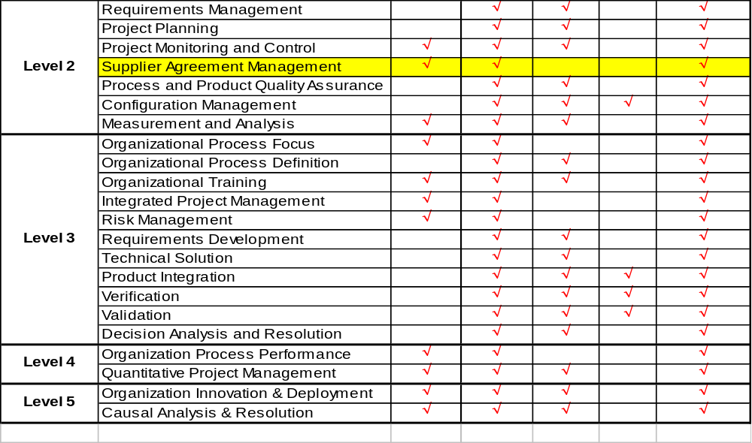
Process Area’s Mapping with Different Roles
Sr. Mgmt PM PL/TL TM QC

Slide 25
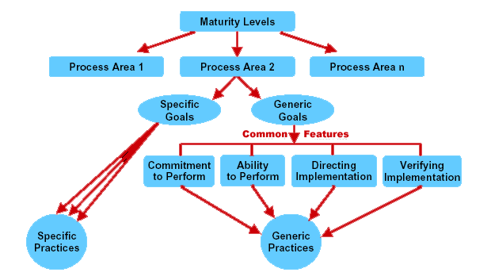
Staged

Slide 26
The Maturity Levels
Focus on process improvement
Level 5 :
Optimising
Process and product quality are quantitatively measured
and controlled
Level 4 : Quantitatively
Managed
Process well understood and institutionalised
across the organisation
Level 3 : Defined
Project can repeat previously done
tasks; project mgmt. system is in place
Level 2 : Managed
Process unpredictable
and poorly controlled
Level 1 : Initial

Slide 27
Level 1: Initial Maturity Level
In
Out
Performance driven by the competence and heroics of individual people.
High quality and exceptional performance possible so long as best people can be hired.
Unpredictable - for good or bad.
Software Management is a “black art “
Reliant on late night sittings
The major problems facing the organisation are managerial, not technical.
Notes:
Mention about learning curves when heroes leave and new people join.
Results never repeatable
Schedules directed by Management
Processes in the heads of gurus!!

Slide 28
Process Areas at Initial Level
Initial (Level 1)
NO PROCESS AREAS
Notes:
Here,
Consistency and compliance to standards driven by management priorities - usually schedule is the top priority
High quality and exceptional performance possible so long as the best people can be hired
Unpredictability - for good or bad

Slide 29
Level 2: Managed Maturity Level
Software project management processes are documented and followed
Successful practices developed on earlier projects can be repeated
A series of black boxes with defined check points
Focus is on the projects’ level
In
Out

Slide 30
Process Areas at Managed Level
Managed (Level 2)
Initial (Level 1)
  Requirements Management
  Project Planning
  Project Monitoring and Control
  Supplier Agreement Management
  Process and Product Quality Assurance
  Configuration Management
  Measurement and Analysis

Slide 31
Level 3: Defined Maturity Level
In
Out
Project management processes are institutionalised
Organisation has a valuable database on different processes for different circumstances.
A dedicated group of people (SEPG) spearheads the entire software process deployment efforts.
Roles and responsibilities in the processes are clearly understood
Contd....
Notes:
Institutionalisation - the building of infrastructure and corporate culture that supports methods, practices, and processes so that they are the ongoing way of doing business, even after those who originally defined them are gone.
“That’s the way its done here”

Slide 32
Level 3: Defined Maturity Level (Contd...)
Project tracking done with high visibility.
Early detection of defects through effective Peer Reviews
Training is given to all employees on pro-active basis
Defined processes for co-ordination between various groups.
The Focus is now at the Organisational Level

Slide 33
Process Areas at Defined Level
Defined (Level 3)
Organizational Process Focus
Organizational Process Definition
Organizational Training
Integrated Project Management
Risk Management
Requirements Development
Technical Solution
Product Integration
Verification
Validation
Decision Analysis and Resolution

Slide 34
Level 4: Quantitatively Managed Maturity Level
In
Out
The entire emphasis is on the Data.
Statistical Process Control (SPC) techniques are applied to address special cases of process variation
Contd....
Notes:
Management has an objective basis for making decisions
Management is able to predict performance within quantified bounds

Slide 35
Level 4: Managed Maturity Level (Contd...)
Identify the root cause of the problem
Upper Limit
Lower Limit
Feedback from data analysis from earlier phases are used to correct plan/course of action for subsequent phases
Sizing, Effort, Staffing and Schedule estimates based on formal estimation procedures using past data
Planned duration & completion clearance of testing based on predicted number of remaining defects.
Quantitative target setting for Quality objectives.

Slide 36
Process Areas at Quantitatively Managed Level
Managed (Level 4)
Organization Process Performance
Quantitative Project Management

Slide 37
Level 5: Optimising Maturity Level
Software process is continuously improved.
  Systemic Defect Identification
  Process Improvement Suggestion Box
Organisation is well-equipped to address new technology
  Research Tracking, Competition Benchmarking
  Technology selection and induction
    Conferences, Workshops, Training
    Technology Demonstrator Projects
    Hiring/Consultancy, Acquisition
  Technology Obsolescence (Forecasting and Replacement planning)
Contd....
Notes:
Mention about learning curves when heroes leave and new people join.
Results never repeatable
Schedules directed by Management
Processes in the heads of gurus!!

Slide 38
Level 5: Optimising Maturity Level
Organisational boundary levels are altered or shifted to identify and eliminate causes of poor performance.
Process improvement is done by one and all.
Note the present continuous sense (optimising) as opposed to other maturity levels.
In
Out
Contd....
Notes:
Mention about learning curves when heroes leave and new people join.
Results never repeatable
Schedules directed by Management
Processes in the heads of gurus!!

Slide 39
Key Process Areas at Optimising Level
Optimizing (Level 5)
Organization Innovation & Deployment
Causal Analysis & Resolution

Slide 40
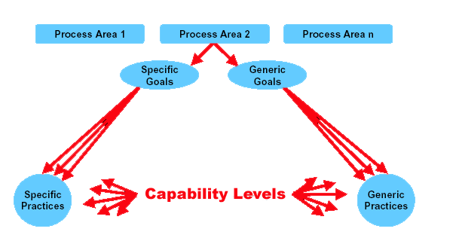
Continuous

Slide 41
Comparison
Continuous Staged
Representation Representation
Level Capability Levels Maturity Levels
0 Incomplete N/A
1 Performed Initial
Managed Managed
Defined Defined
4 Quantitatively Quantitatively
Managed Managed
5 Optimizing Optimizing

Slide 42
Assessment
Process is called SCAMPI (Similar to CBA IPI)
  Identifying external agency and external Lead assessor
  Forming an internal assessment team
  Training the team for assessment process
  Identifying projects for IDR (Initial Document Review) and for Interview
  Forming FAR (Functional Area Reps)
  Carrying out the assessment (Interviews and Surveys)
  Drafting report and presenting to FARs , PM and Senior Mgmt.
  Submitting final report to SEI

Slide 43
Quality Management System
Quality Policy with Stated Quality Goals
Commitment, both by management and employees
Documented
Controlled
Effective
Verifiable
Continuous Improvement

Slide 44


Quality Management System..
Elements of Quality Management System
  Policies
  Software Development Life Cycle
  Processes/Procedures
  Forms/Templates/Checklists
  Tools

Slide 45
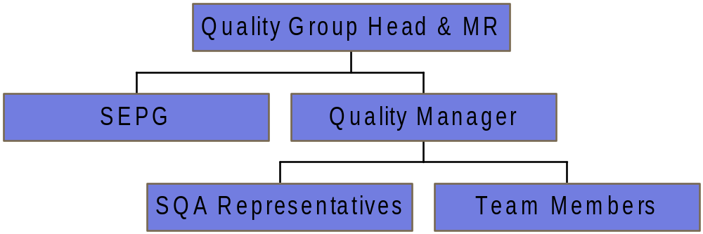
Quality Organization

Slide 46

ISO VS CMMI
ISO
  Generic Standard
  Applicable for all kinds of organizations
  Addresses the minimum criteria for an acceptable Quality System
  Contains clauses
  Documentation is called QS manual
  Certification Audit is like an examination
  Result of the certification is a pass/ fail outcome
CMMI
  Maturity Model
  Applicable only to software organizations
  Emphasizes on continuous process improvement
  Contains “Process Area” (PAs)
  Documentation is called work products and artefacts
  Final assessment is collaborative
  The result of the assessment is a quantitative score of the maturity of software development processes
COMMON TO BOTH
“Say what you do; do what you say”

Slide 47
ETVX Paradigm
Define the activities
Flow of activities
Transformation path
Control & decision points
TASKS
Define entry criteria
Inputs
When
Events
Define exit criteria
Deliverables
When
How to use
Whom to use
ENTRY
EXIT
Define V&V steps
Review
Inspection
Testing
VERIFICATION &
VALIDATION

Slide 48
Proposed QMS Structure
Quality Manual
Project Management
Guide
Process Handbook
Procedures
Templates
Forms
Checklists
Standards and
Guidelines

Slide 49
Quality Manual
Provides very high level definition of practices adopted by organization
Is a guide for understanding the QMS
It defines
  Quality Policy
  Roles and responsibilities within the organization
  Top level practices to be adopted and references to other manuals
  Mapping between CMMI requirements and QMS documentation
Back

Slide 50
Project Management Guide
Provides framework for planning, tracking and managing projects
It defines set of activities to be completed for the following phases
  Contractual
  Project Initiation
  Project Planning
  Project Execution and Tracking
  Project Closure
Back

Slide 51
Process Handbook
Defines
  Methodology and various lifecycle stages in a project
  Operational processes for the projects
Details the phases for the identified project types
Two process handbooks defined are
  Development
  Maintenance
Back
Notes:
For development handbook tell about Waterfall, RUP and Spiral

Slide 52
Procedures
Defines the procedures for carrying out specific activities.
Each procedure, defines
  Purpose
  Scope
  Roles and Responsibilities
  Formats Used
  Reference Documents
  Entry Criteria
  Tasks
  Verification and Validation
  EXit Criteria
Back

Slide 53
Other QMS Documents
Templates
  A specified logical structure for a collection of data, including allowable ranges for their values and other data consistency specifications
Forms
  Document with blanks for the insertion of details or information
Checklists
  Provides a list of items to be noted, checked, or remembered
Standards and Guidelines
  Gives conventions and practices for carrying out a task efficiently
  Includes templates for various documents
  Provides standard ways of performing the tasks
Back

Slide 54

productivity through quality...
...let us pledge together…

Slide 55



